Slide 1

“Employees Performance System”
Supervisor:
Mrs.
Shalika Ma’am
Members:
Arya Mishra
Babli Pandey

Slide 2
INTRODUCTION
There will be 2 types of user groups: Employee and Admin. Employee group can consist of roles like Software Engineer, Software QA, Engineering Manager, Engineering Director, HR, IT Consultant, Finance Consultant, CTO, CEO etc. One employee can have multiple roles. Main idea behind the performance system is to check the performance of the employees. An employee who is the reporting manager of another employee/employees is eligible to provide ratings(Mentorship required, low vital, high vital, star) of his/her teams.

Slide 3
TECHNOLOGY USED
PHP : PHP is a widely used server-side programming language that’s become increasingly fast and powerful over the years. PHP works well with HTML and databases, making it a great language for anyone interested in building dynamic web applications.
HTML : HTML is a markup language which is used for creating attractive web pages with the help of styling, and which looks in a nice format on a web browser. An HTML document is made of many HTML tags and each HTML tag contains different content.
CSS : CSS stands for Cascading Style Sheets. It is a style sheet language which is used to describe the look and formatting of a document written in markup language. It provides an additional feature to HTML. It is generally used with HTML to change the style of web pages and user interfaces.
MYSQL : MySQL is a relational database management system based on the Structured Query Language, which is the popular language for accessing and managing the records in the database. MySQL is open-source and free software under the GNU license. It is supported by Oracle Company.

Slide 4
MODULES
01
REPORTING MANAGER
02
ADMIN
03
EMPLOYEE

Slide 5
PROJECT OBJECTIVE
1 Add an employee
2 Update an employee details
3 Delete an employee details
4 Employee can do his/her self-evaluation
5 Reporting Manager checks the performance of employees under him and rate him

Slide 6
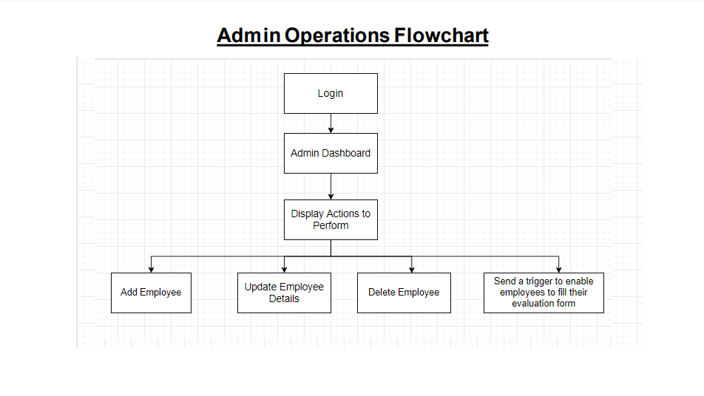
ADMIN FLOWCHART

Slide 7
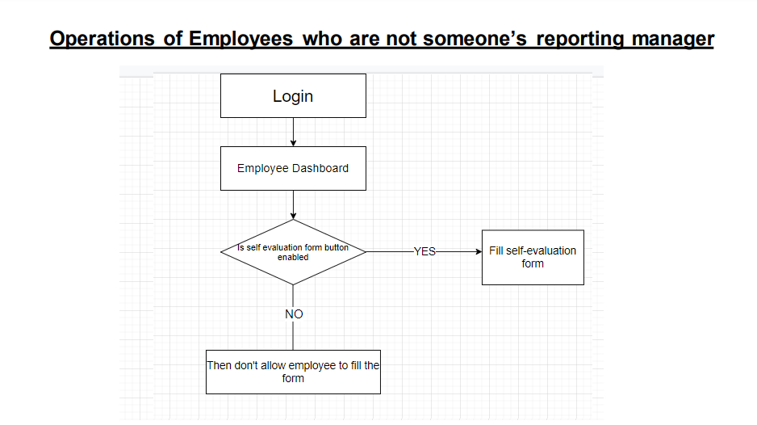
EMPLOYEE WHO ARE NOT SOMEONE’S REPORTING MANAGER

Slide 8
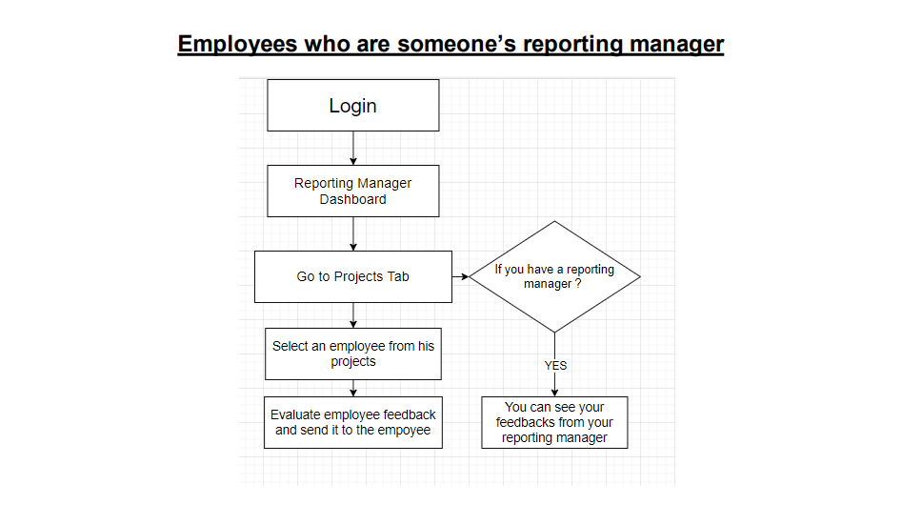
EMPLOYEE WHO ARE SOMEONE’S REPORTING MANAGER

Slide 9
CONCLUSION
Performance Appraisals is not only an evaluation process of a person’s performance with reward / punishments as an outcome of it. Rather, its intent is to align and improve the performance of an individual to meet the overall organizational goal.
This project is used for computerizing employee Performance in offices or organizations. The software keeps record of employee’s performance. The software is capable of easy storage of information related to employee through database.

